Slide 1

ISR-PROJECT : Predicting Future Jobs Based on Scholarly Research Articles
Mohammed Abdul Moyeed (Z1912165) Northern Illinois University, DeKalb, IL USA
Omer Bin Ali Bajubair (Z1905006) Northern Illinois University, DeKalb, IL USA

Slide 2
Overview
Executive Summary
Introduction
Problem Significance
Background Information
Dataset
Related Work
Proposed Method
Evaluation
Results
Code Review
Conclusion and Future Work
Acknowledgements
References

Slide 3



Executive Summary
We will be measuring the impact of scholarly research articles on job market.

Slide 4
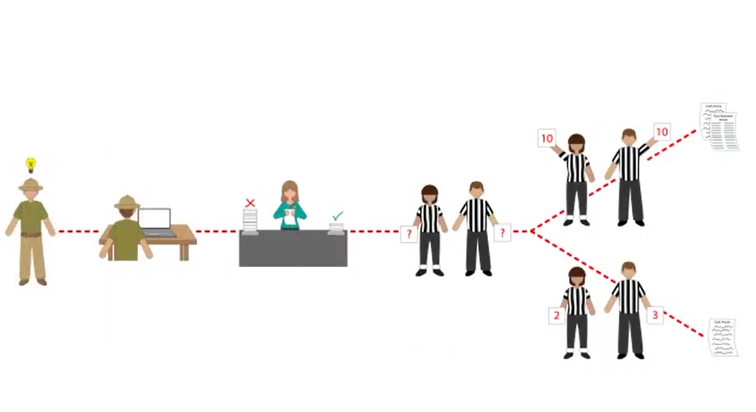
What is Scholarly Research Articles?

Slide 5
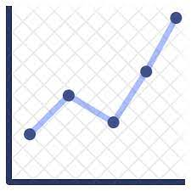


Data gathering from websites like Indeed, LinkedIn to see if an influx in research papers published has a correlation with the jobs being published in the market.
We want to predict the future jobs that can be posted based on current research articles published.

Slide 6
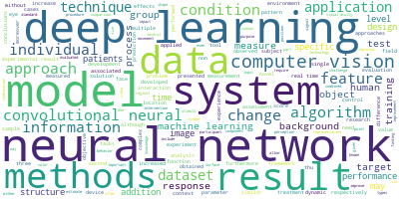
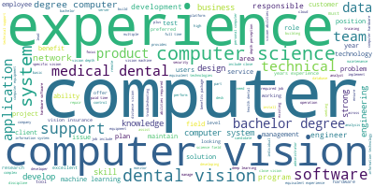
WORD CLOUD :Computer Vision (Papers vs Jobs )

Slide 7
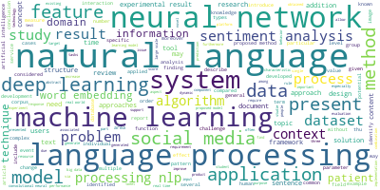
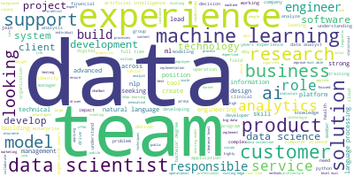
WORD CLOUD : NLP (Papers vs Jobs )

Slide 8
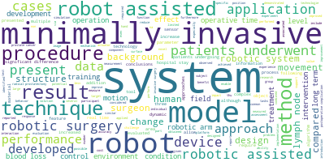
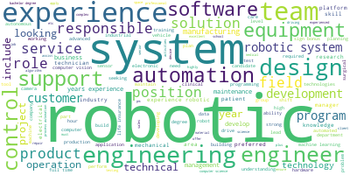
WORD CLOUD : Robotics (Papers vs Jobs )

Slide 9
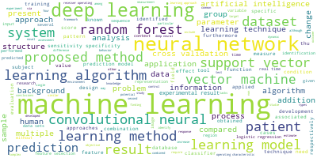
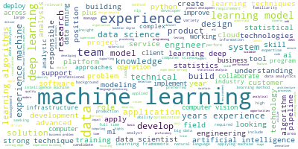
WORD CLOUD :Machine Learning (Papers vs Jobs )

Slide 10
Problem Significance
Is there a correlation between publication of scholarly articles and the jobs being posted by the companies?
Predicting the effect of an influx of research articles on the future job market.
The results of our research will help policy makers, investors, and companies make optimal decisions.

Slide 11


Background Information
Job Market has been varying over the years due to many reasons, most recent one is Covid-19.
The research on employability has been going on from a long time to predict how each factor has or will affect it.

Slide 12


DATASET
Collected Data from Indeed.
Collected Scholarly research articles from Dimensions.

Slide 13
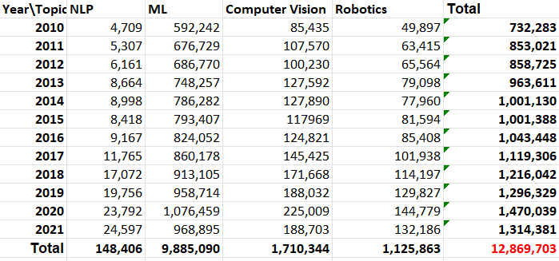
Statistics : Count of Research Papers from Dimensions

Slide 14
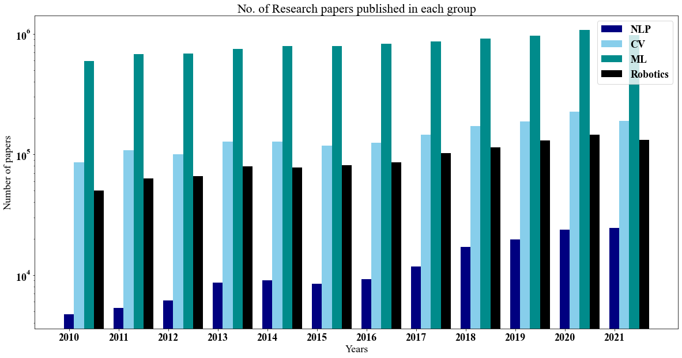
Research Papers published Each year

Slide 15
Statistics : Count of jobs in previous years on Indeed
2018:
'Computer Vision': 108181
'Machine Learning': 71489
'NLP': 13221
'Robotics': 61560
2019:
'Computer Vision': 108243
'Machine Learning': 71570
'NLP': 13221
'Robotics': 61611
2020:
'Computer Vision': 108243
'Machine Learning': 71570
'NLP': 13221
'Robotics': 61611
2021:
'Computer Vision': 108243
'Machine Learning': 71570
'NLP': 13221
'Robotics': 61611

Slide 16
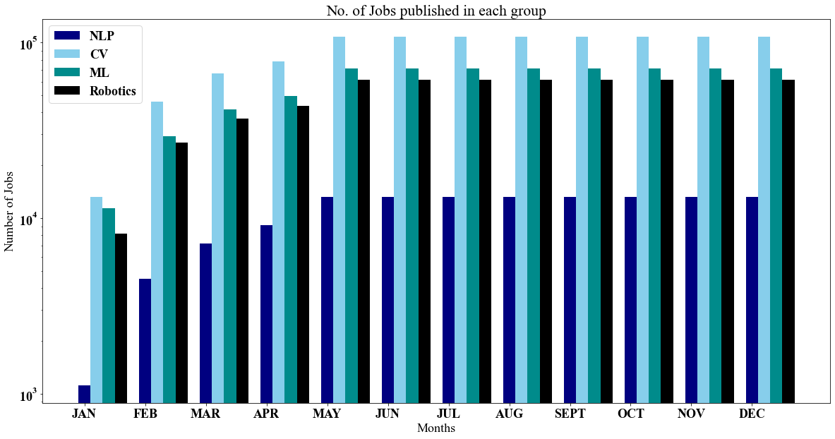
Jobs in Last Year

Slide 17
Related Work
Previous publications focusses on employment and what factors were more prominent in employability.
Predicts the skill shortage in labor market based on a machine learning Approach.
Predicted future earning based on the five broad fields of study.

Slide 18
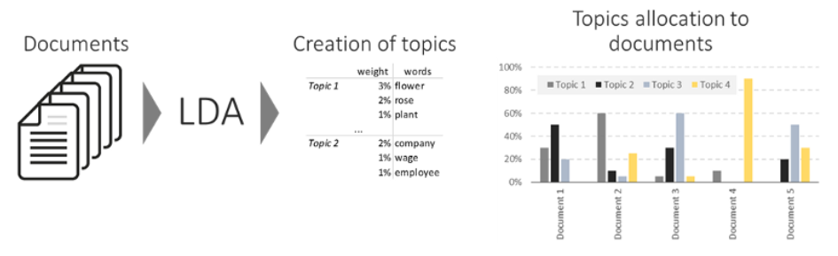
Proposed Method

Slide 19

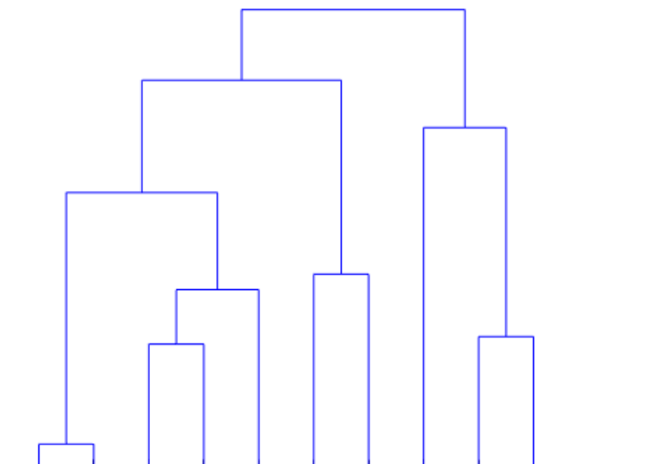
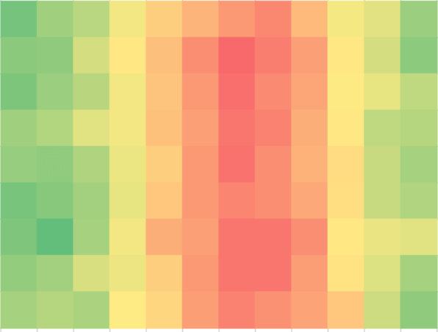
Evaluation
Correlation between frequency or research papers publish and similar topic Jobs posted.
Visualizations in the form of Heatmaps and Dendograms.

Slide 20



CODE REVIEW

Slide 21
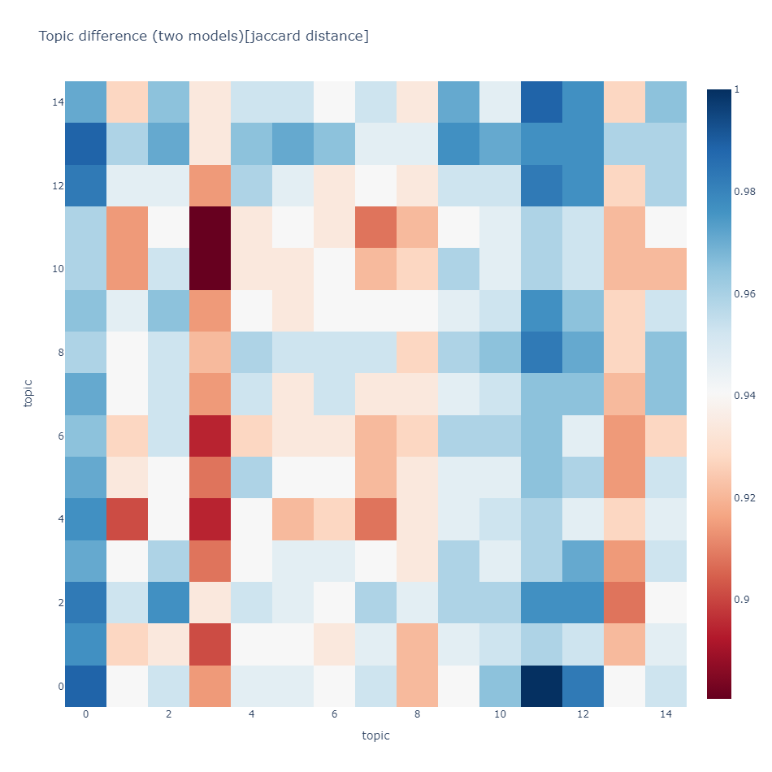
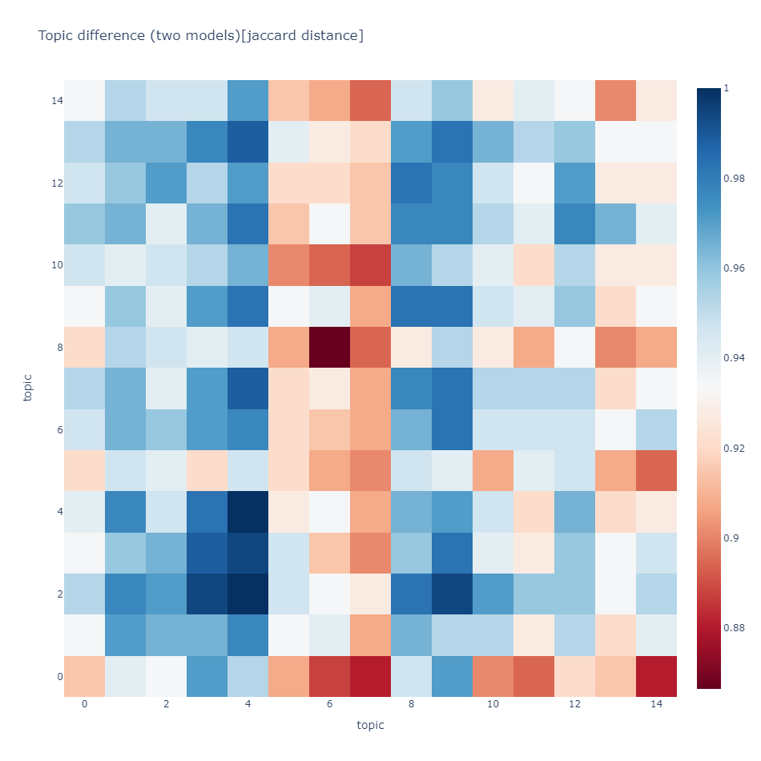
Results - LDA Comparison - NLP
Notes:
NLP

Slide 22
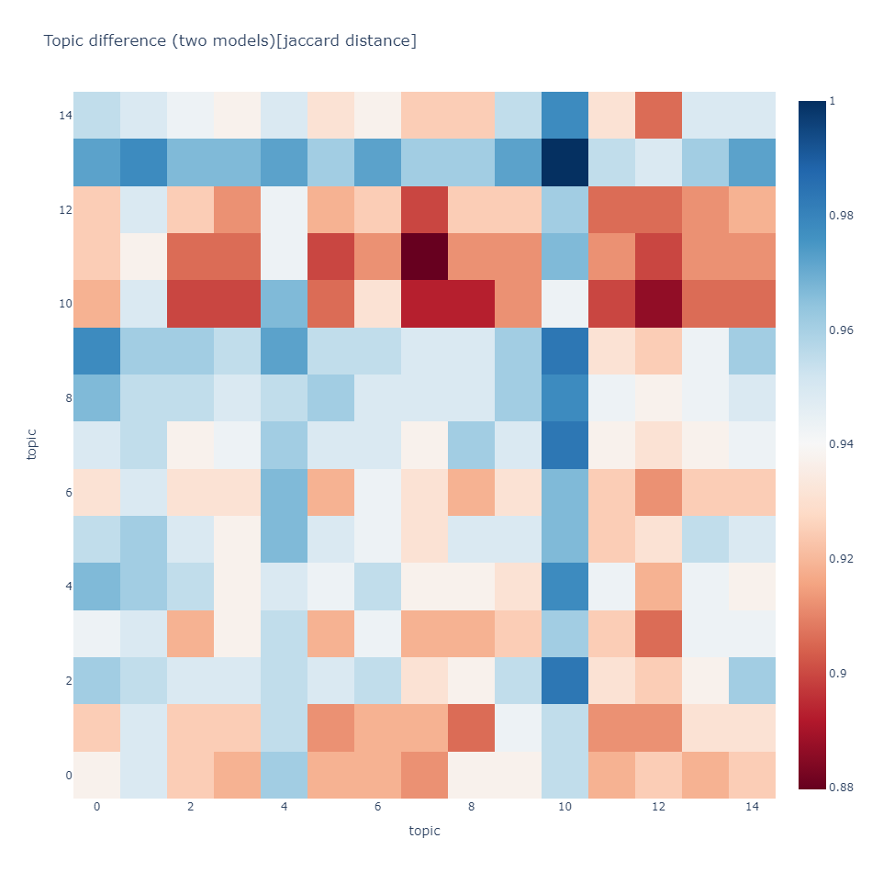
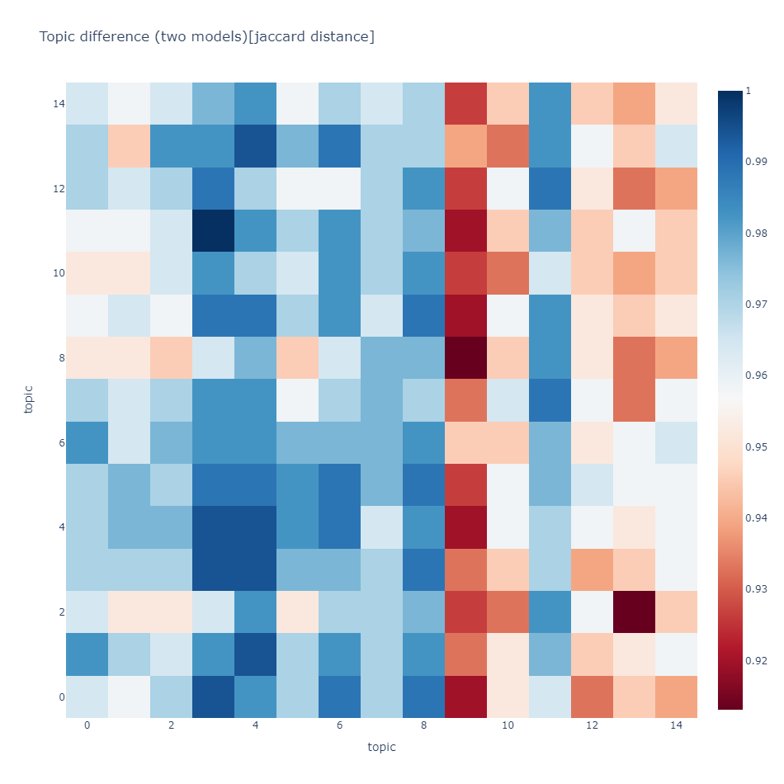
LDA Comparison – Computer Vision
Notes:
CV

Slide 23
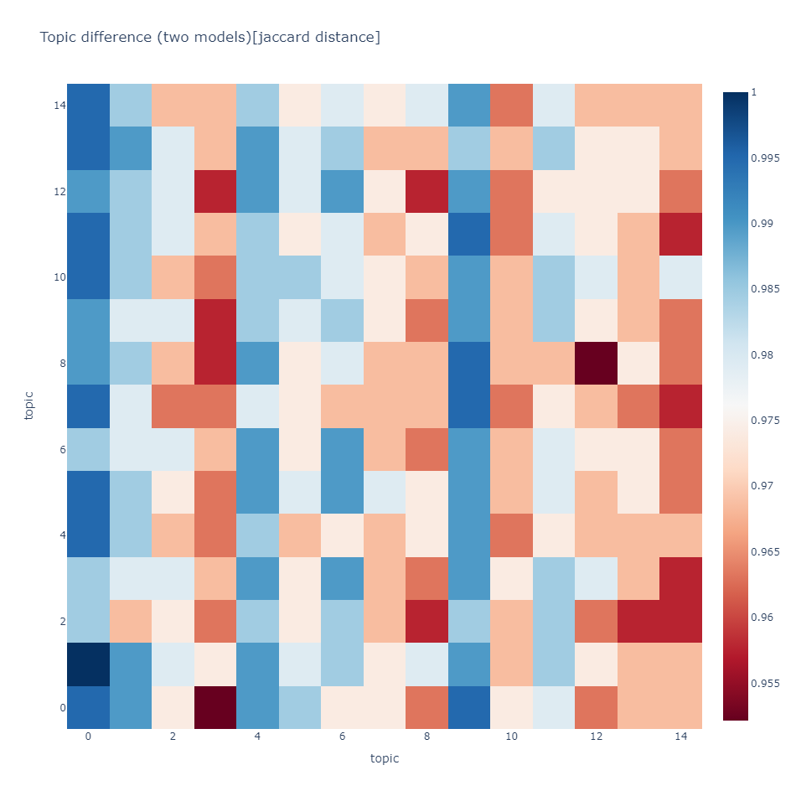
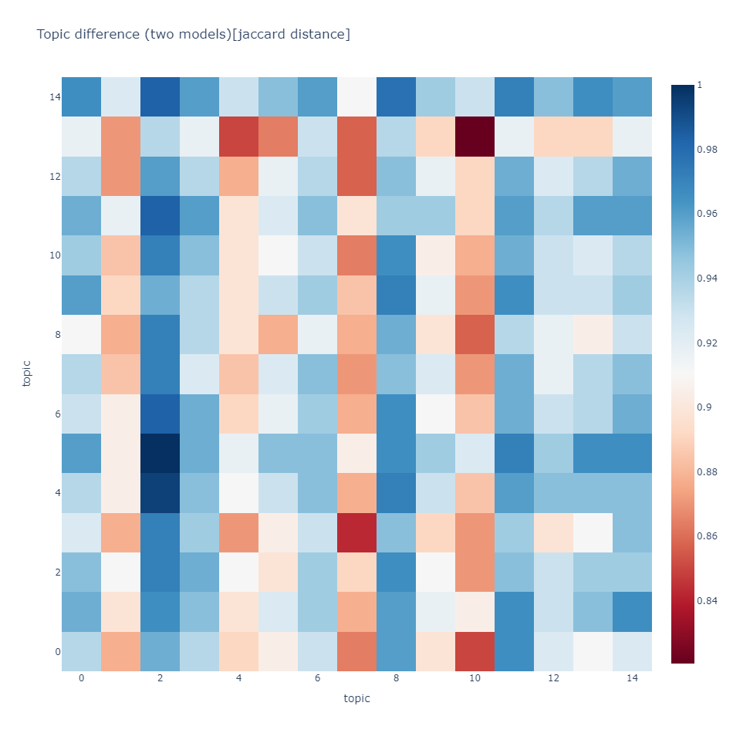
LDA Comparison – Machine Learning
Notes:
ML

Slide 24
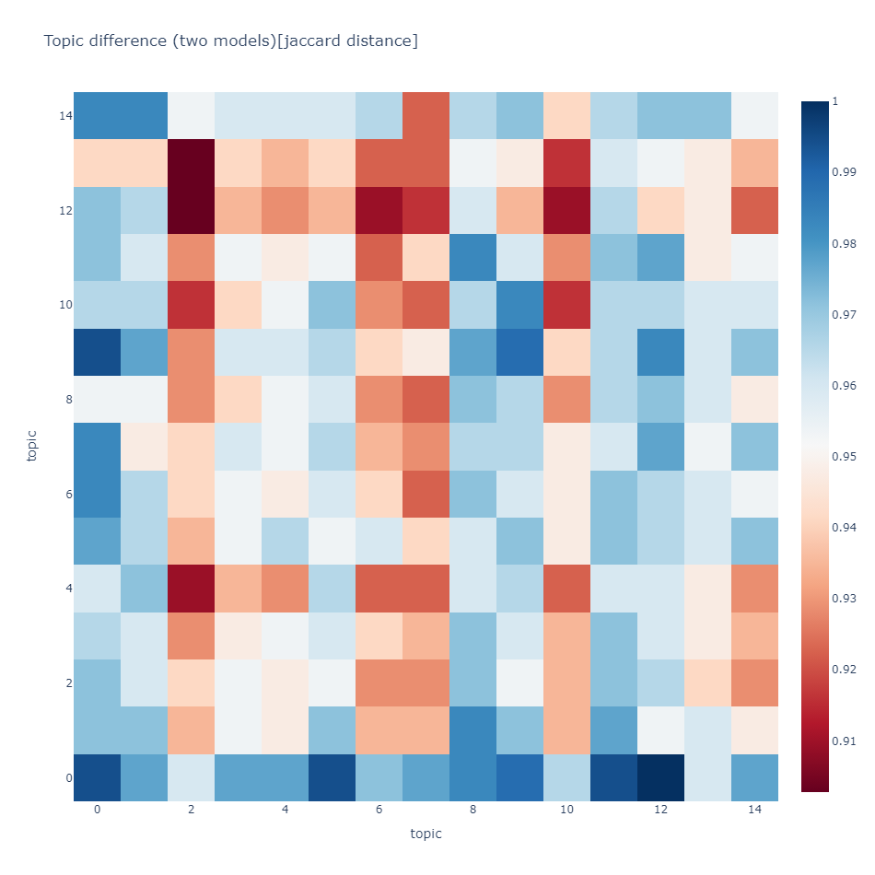
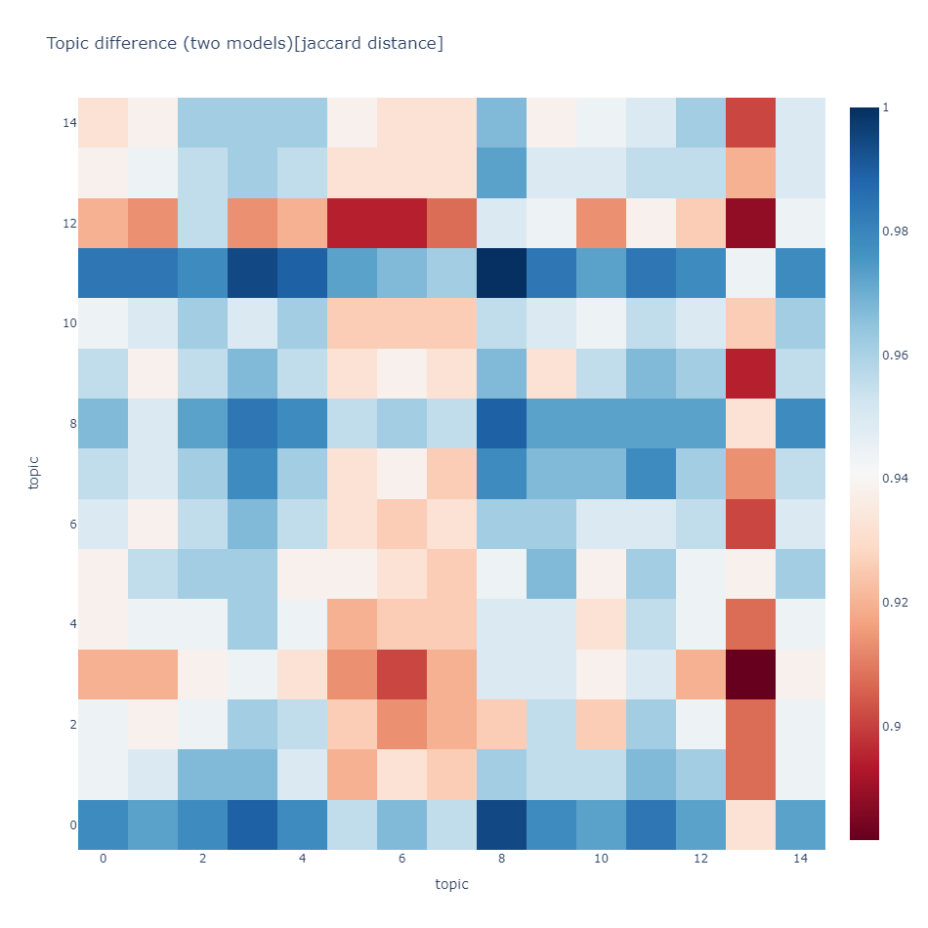
LDA Comparison - Robotics

Slide 25
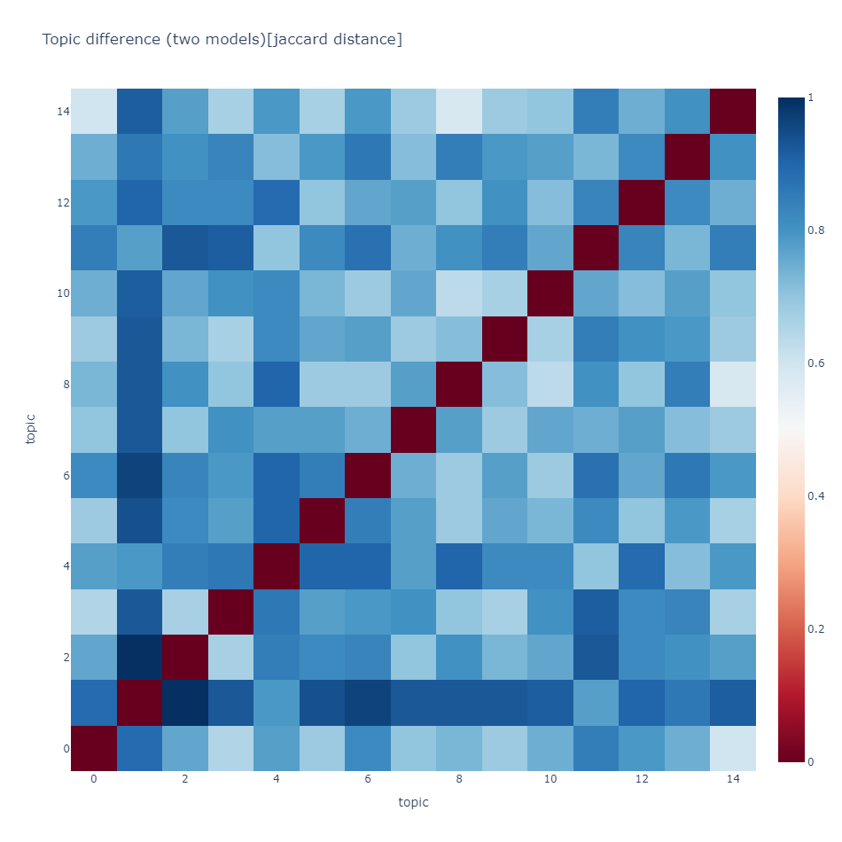
Conclusion

Slide 26
Future Work
Improvised Dataset
Full Text of Scholarly Articles

Slide 27
Acknowledgements
Dr. Hamed Alhoori ( For all the help with project related doubts )
Abdul Rahman Shaik ( PhD CS NIU )
Indeed , Dimensions , LinkedIn
Scholarly Research Articles
Youtube
Medium
Google , Google Photos
Jupyter Notebook

Slide 28
References
[1] By BRIAN BEERS, https://www.investopedia.com/terms/ j/job-market.asp
[2] Mezhoudi, N., Alghamdi, R., Aljunaid, R. et al. Employability prediction: a survey of current approaches, research challenges and applications. J Ambient Intell Human Comput (2021).
[3] PREDICTING EMPLOYMENT THROUGH MACHINE LEARNING By Linsey S. Hugo (May-2019)
[4] AI, Robotics, and the Future of Jobs BY AARON SMITH AND JANNA ANDERSON
[5] Arthur R (2021) Studying the UK job market during the COVID-19 crisis with online job ads. PLoS ONE 16(5): e0251431. https://doi.org/10.1371/journal.pone. 0251431

Slide 29
[6] Moro E, Frank MR, Pentland A, Rutherford A, Cebrian M, Rahwan I. Universal resilience patterns in labor markets. Nature Communications. 2021;12(1):1–8. pmid:33785734
[7] Berger MC. Predicted Future Earnings and Choice of College Major. ILR Review. 1988;41(3):418- 429. doi:10.1177/001979398804100306
[8] G. Jason Jolley, Predicting North Carolina’s Job Market in 2020
[9] Sandefer, Ryan; Marc, David; Mancilla, Desla; Hamada, Debra. "Survey Predicts Future HIM Workforce Shifts: HIM Industry Estimates the Job Roles, Skills Needed in the Near Future" Journal of AHIMA 86, no.7 (July 2015): 32- 35. [12] N. Dawson, M. -A. Rizoiu, B. Johnston and M. -A. Williams, "Predicting Skill Shortages in Labor Markets: A Machine Learning Approach," 2020 IEEE International Conference on Big Data (Big Data), 2020, pp. 3052-3061, doi: 10.1109/BigData50022.2020.937777 3.

